Slide 1
Problem Statement & Solution
FixieBot: AI-Powered Predictive Fix Recommendations
The Challenge
Our Solution: FixieBot
Customer support , R&D teams are burdened with manual ticket analysis, leading to:
FixieBot leverages advanced AI to automate and optimize the support process:
Significant delays in resolution
Predicts optimal fixes for incoming tickets
Frequent misclassification of issues
Identifies affected products/modules accurately
Decreased customer satisfaction
Provides top 10 fix suggestions with confidence scores
Inefficient resource allocation
Continuously improves through a robust feedback loop

Slide 2
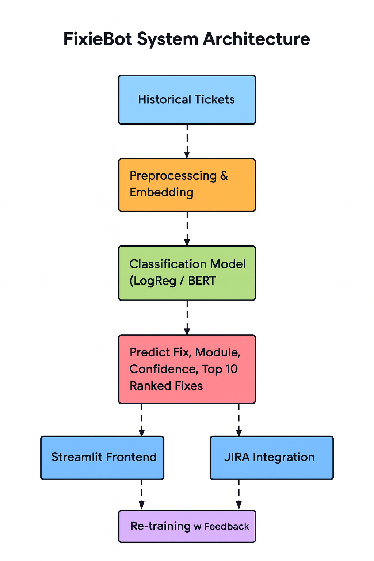
FixieBot System Architecture
A robust and secure design ensures reliable performance and data integrity.

